Slide 1
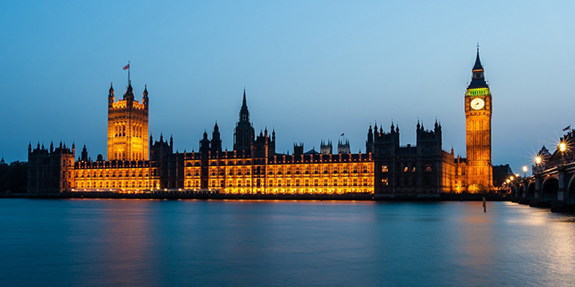
About UK
By Sahasra

Slide 2
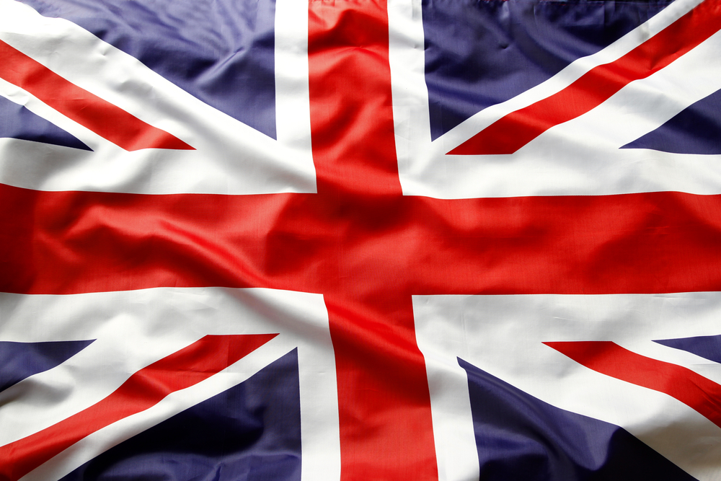
About UK
The United Kingdom, made up of England, Scotland, Wales and Northern Ireland, is an island nation in northwestern Europe. England – birthplace of Shakespeare and The Beatles – is home to the capital, London, a globally influential centre of finance and culture. England is also site of Neolithic Stonehenge, Bath’s Roman spa and centuries-old universities at Oxford and Cambridge.
This Photo by Unknown Author is licensed under CC BY-NC-ND

Slide 3
Short Info
Capital: London
Dial code: +44
Prime Minister: Boris Johnson
Currency: Pound Sterling
Full Form: United Kingdom
This Photo by Unknown Author is licensed under CC BY-NC-ND

Slide 4
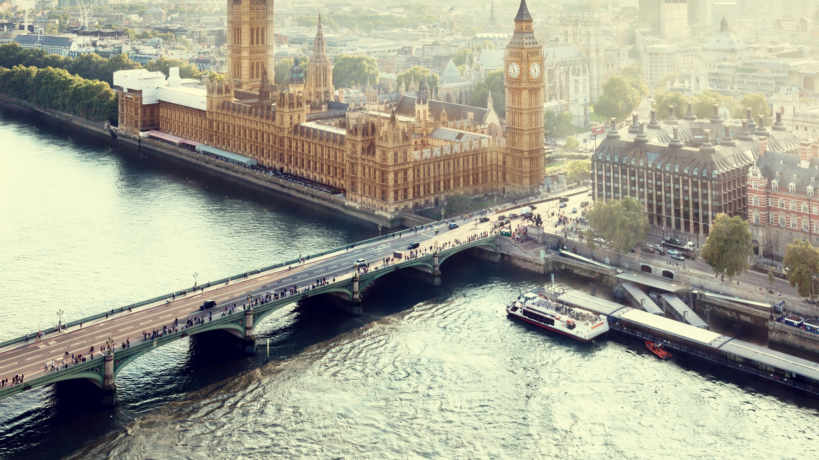
Fun Facts
The 1st King of England made a law that everyone had to be in bed by 8pm.
French was the official language of the nation for 300 years.
There is not a single point in Britain that is more than 75 miles away from a coastline.
The Queen might wish you a happy birthday. ...
Great Britain isn't the United Kingdom
London has the largest library in the world.
The Queen doesn't have a passport
This Photo by Unknown Author is licensed under CC BY-SA

Slide 5
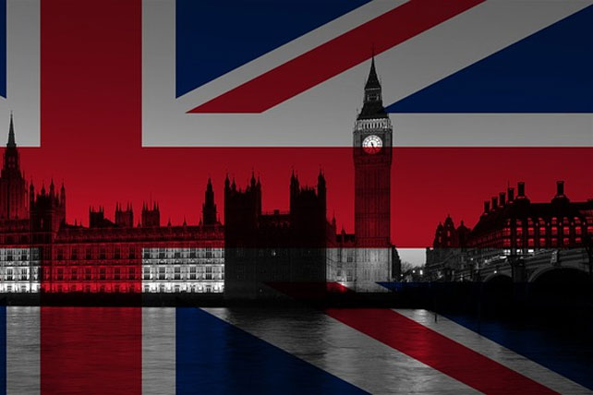
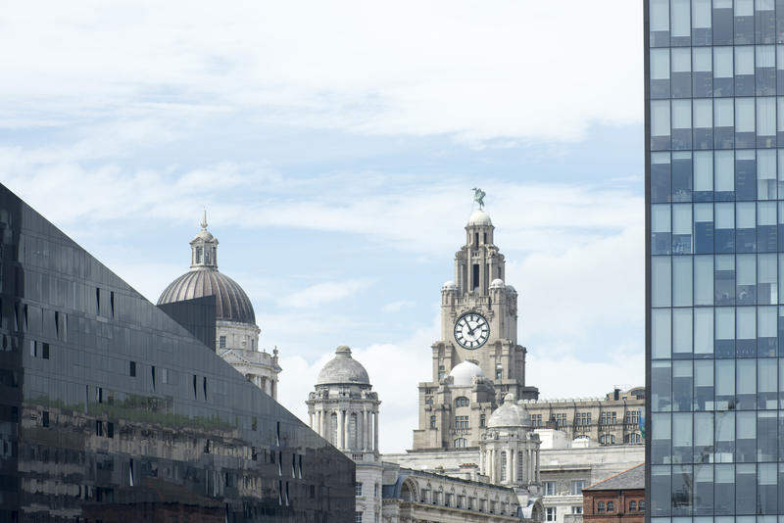
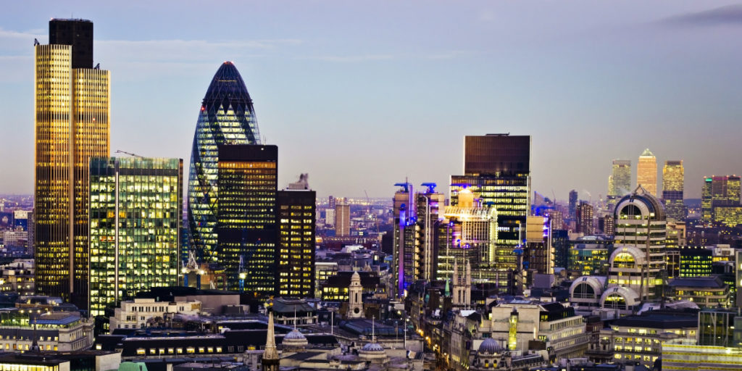
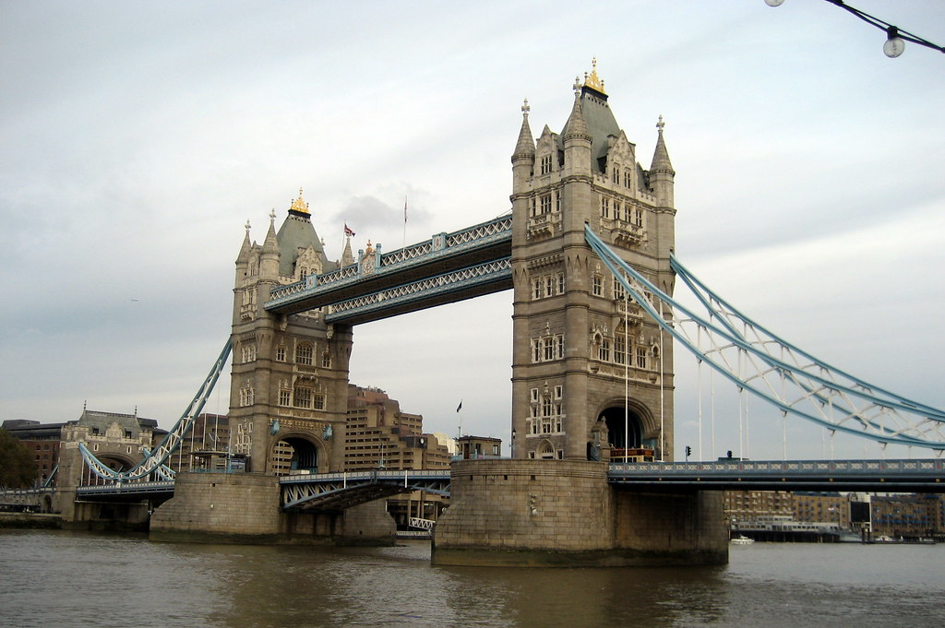
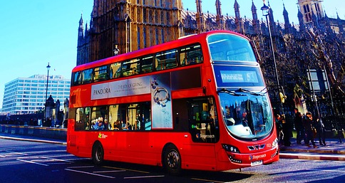
Pictures of UK
This Photo by Unknown Author is licensed under CC BY-SA
This Photo by Unknown Author is licensed under CC BY-SA
This Photo by Unknown Author is licensed under CC BY-NC-ND
This Photo by Unknown Author is licensed under CC BY
This Photo by Unknown Author is licensed under CC BY-NC-ND

Slide 6
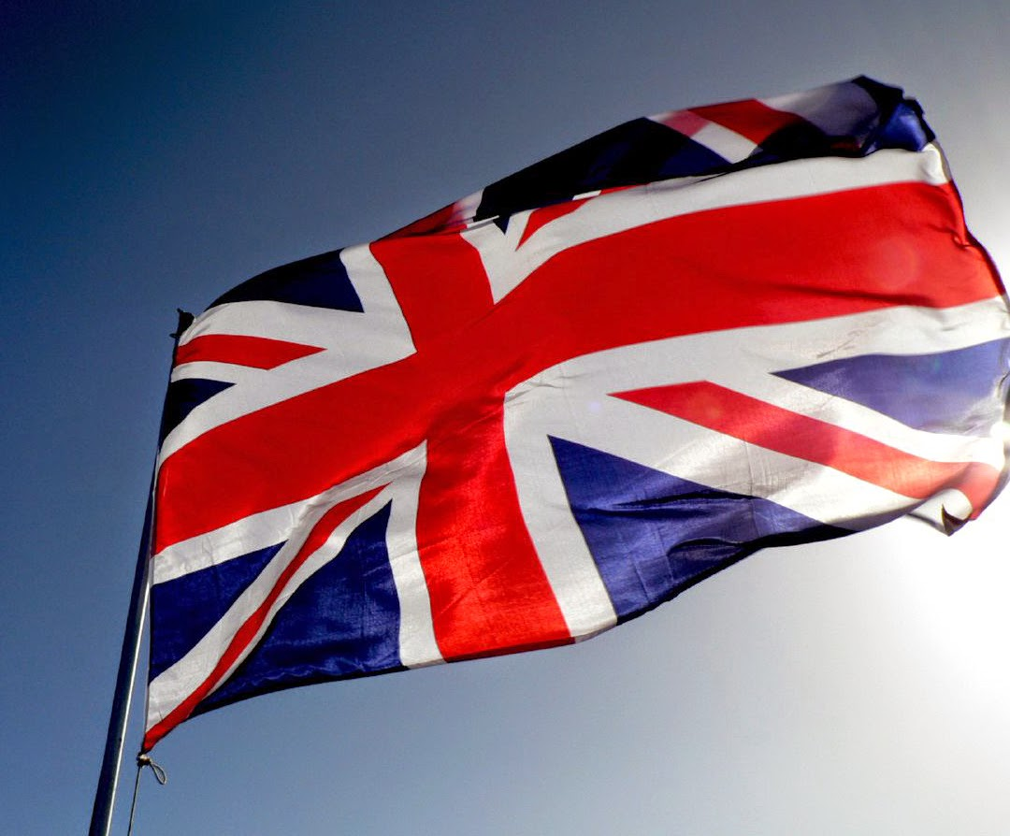
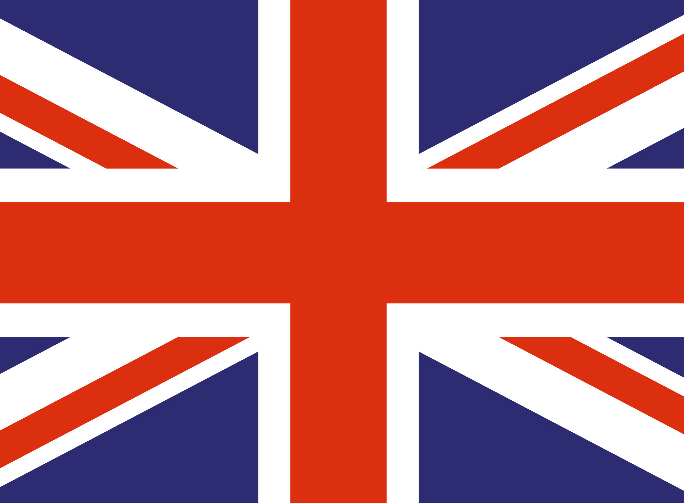
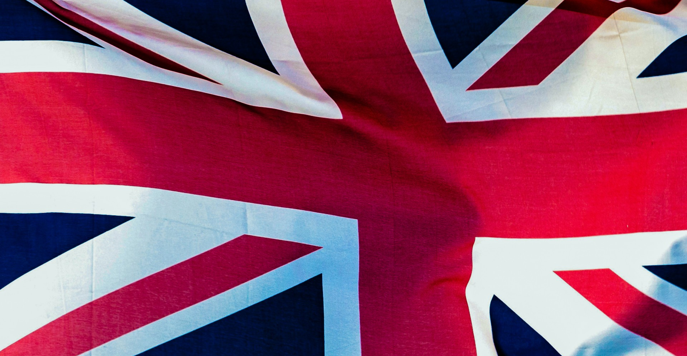
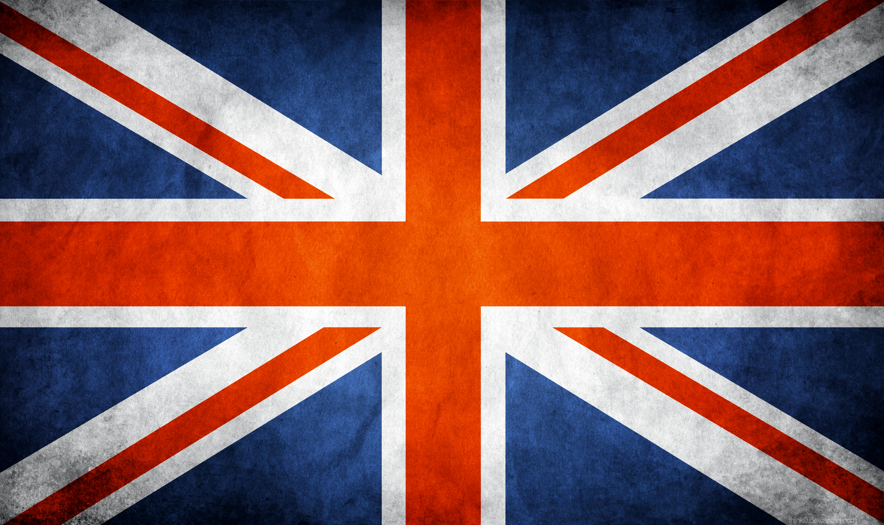
UK Flag
The Union Jack, or Union Flag, is the de facto national flag of the United Kingdom. Though no law has been passed officially making the Union Jack the national flag of the United Kingdom, it has effectively become the national flag through precedent.
This Photo by Unknown Author is licensed under CC BY-NC-ND
This Photo by Unknown Author is licensed under CC BY-SA
This Photo by Unknown Author is licensed under CC BY-NC-ND
This Photo by Unknown Author is licensed under CC BY

Slide 7
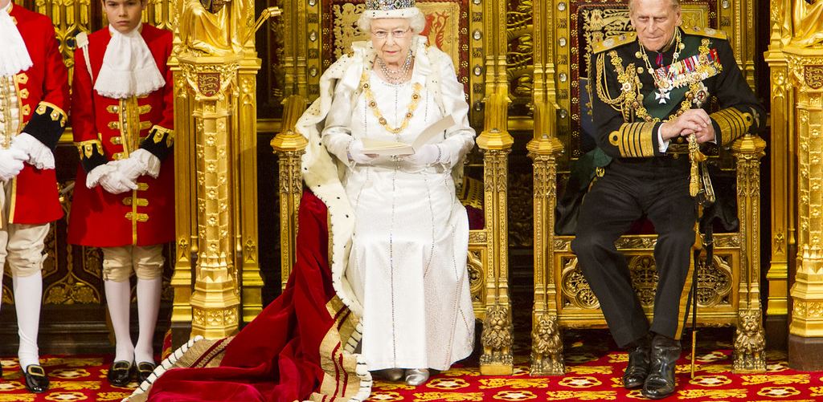
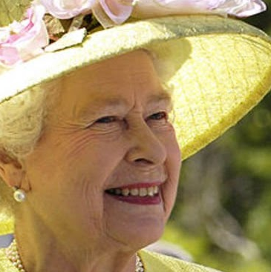
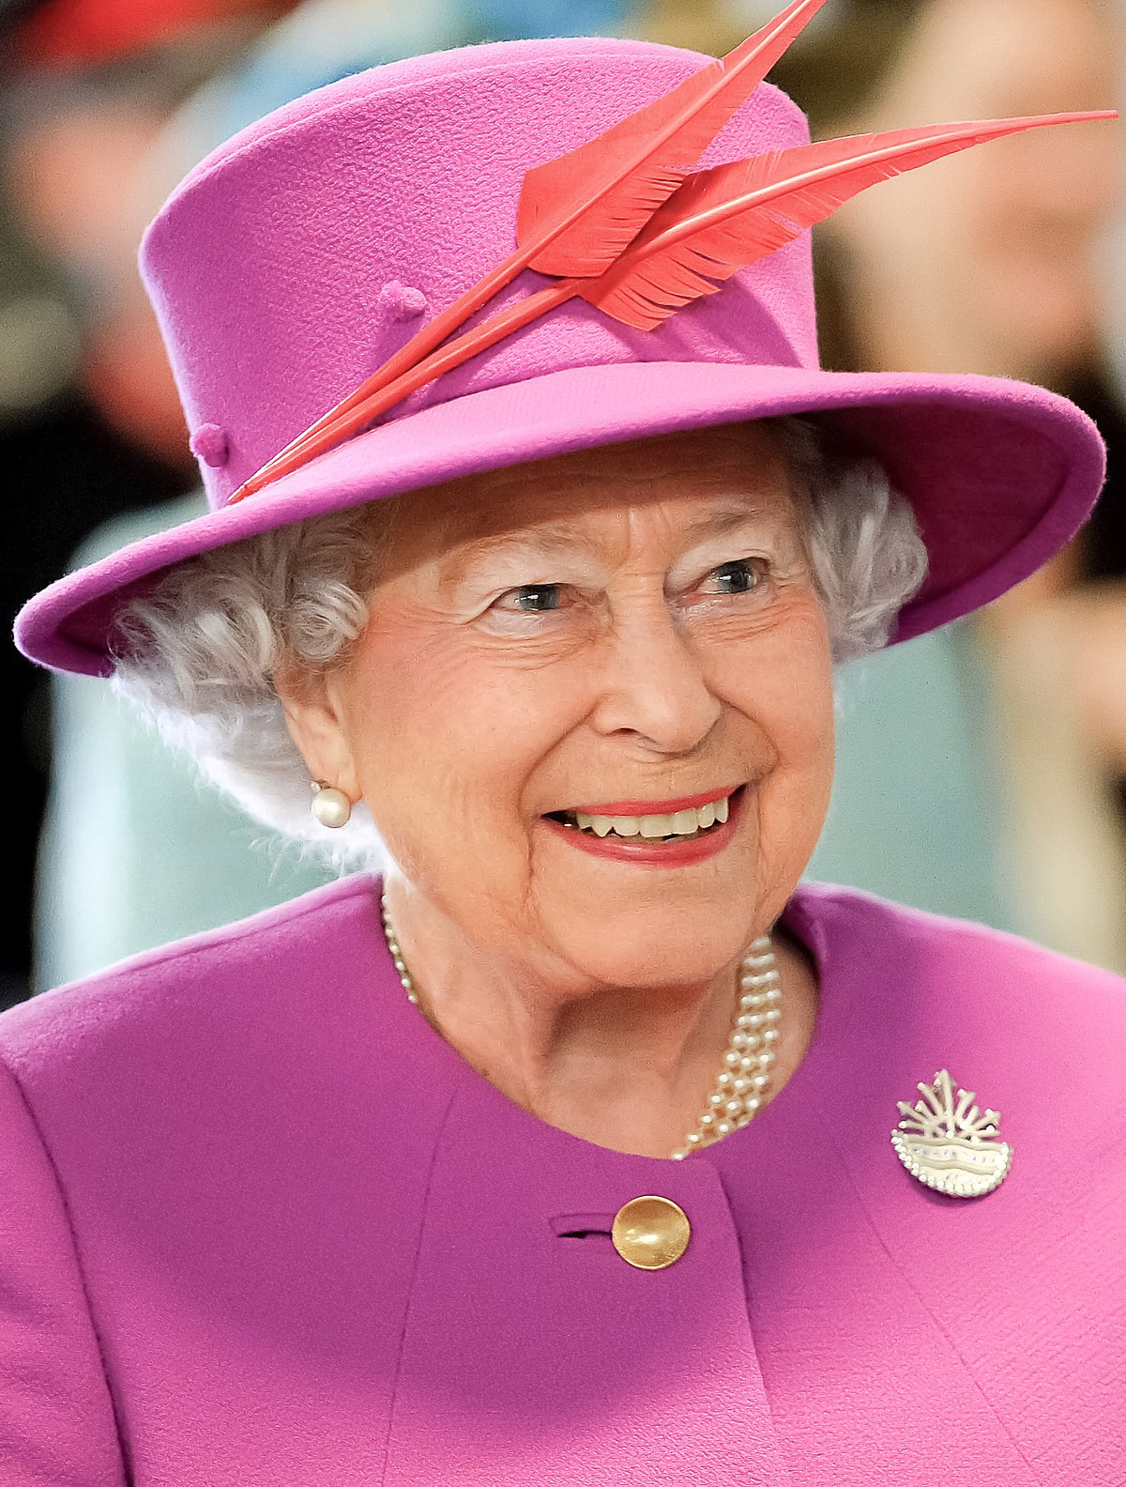
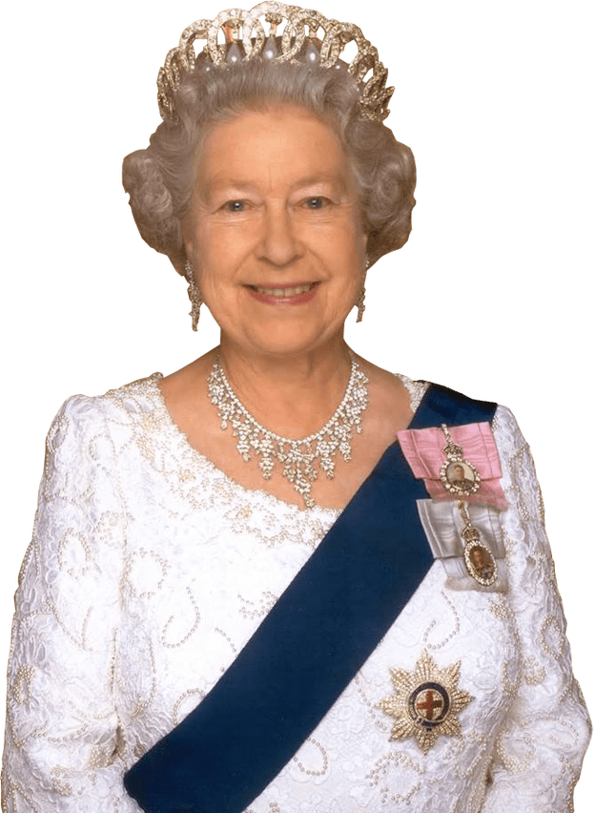
Queen of UK
Elizabeth II is Queen of the United Kingdom and 14 other Commonwealth realms. Elizabeth was born in Mayfair, London, as the first child of the Duke and Duchess of York. Her father ascended the throne in 1936 upon the abdication of his brother, King Edward VIII, making Elizabeth the heir presumptive.
This Photo by Unknown Author is licensed under CC BY-NC
This Photo by Unknown Author is licensed under CC BY-SA-NC
This Photo by Unknown Author is licensed under CC BY-NC
This Photo by Unknown Author is licensed under CC BY-SA

